Slide 1
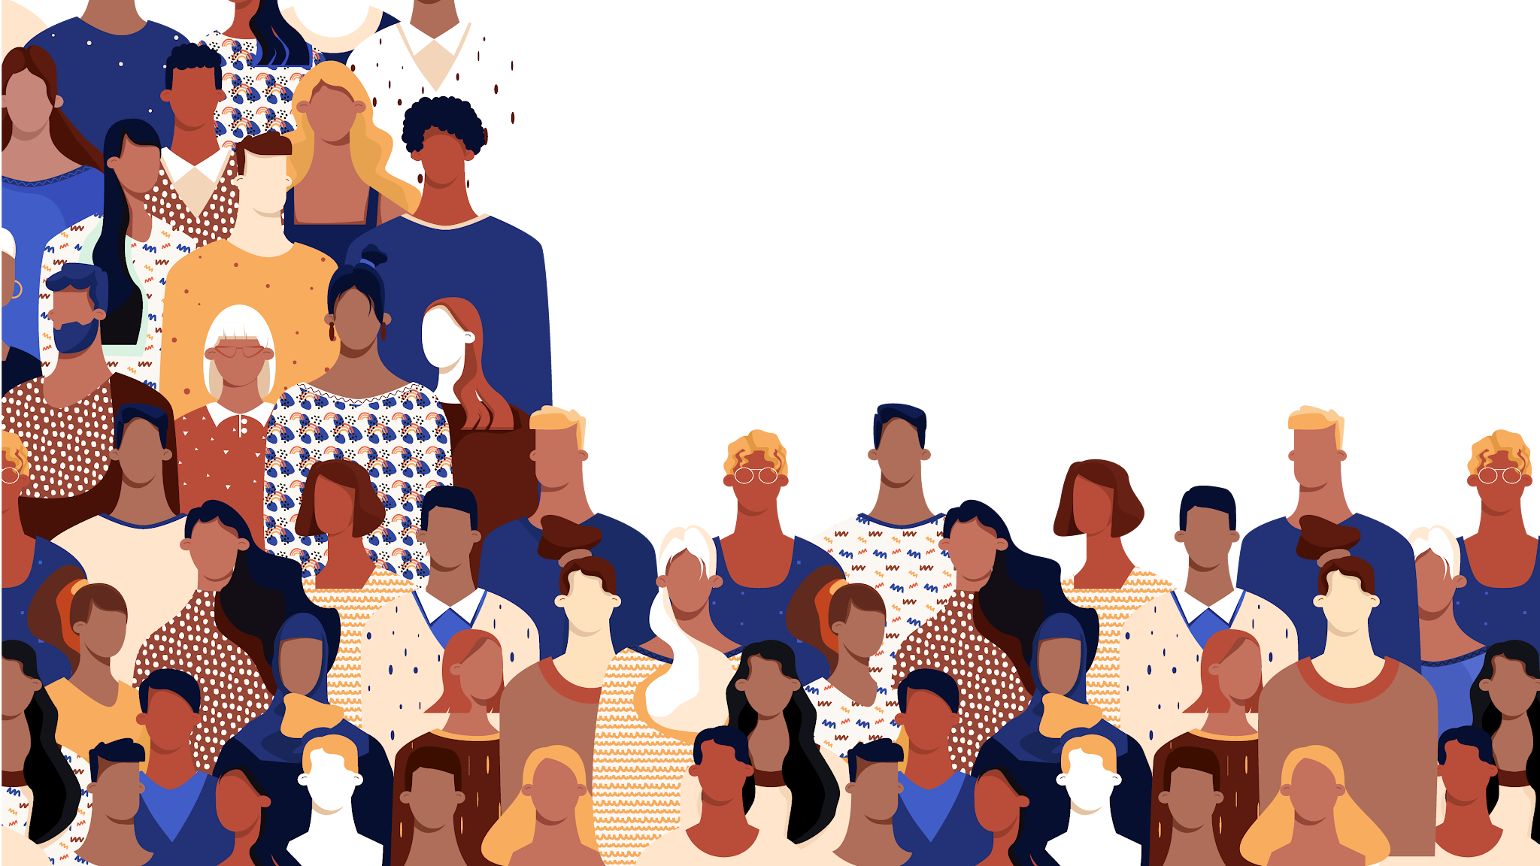
Layers of Me: Unearthing Identity

Slide 2
Name: Alyse
Whole Self
Caring, culturally competent, Confident in my diverse background, advocate for those who are not
Visible Identity:
Women, student, teacher, white
Hidden Identity
Transnational citizen, First Gen Scholar , Multi-ethnic i.e. Ashkenazi Jew ( German Jew) and Italian, multilingual, neurologically diverse, mother, sister, Nerd, Muslim

Slide 3
Name:
Whole Self
Visible Identity:
Hidden Identity

Slide 4
Name:
Whole Self
Visible Identity:
Hidden Identity

Slide 5
Name:
Whole Self
Visible Identity:
Hidden Identity

Slide 6
Name:
Whole Self
Visible Identity:
Hidden Identity

Slide 7
Name:
Whole Self
Visible Identity:
Hidden Identity

Slide 8
Name:
Whole Self
Visible Identity:
Hidden Identity

Slide 9
Name:
Whole Self
Visible Identity:
Hidden Identity

Slide 10
Name:
Whole Self
Visible Identity:
Hidden Identity

Slide 11
Name:
Whole Self
Visible Identity:
Hidden Identity

Slide 12
Name:
Whole Self
Visible Identity:
Hidden Identity

